Slide 1

Form 8/AF 3862 (Flight Eval Worksheet) How-to Guide for PEX 5.12
CAO 19 July 2017

Slide 2
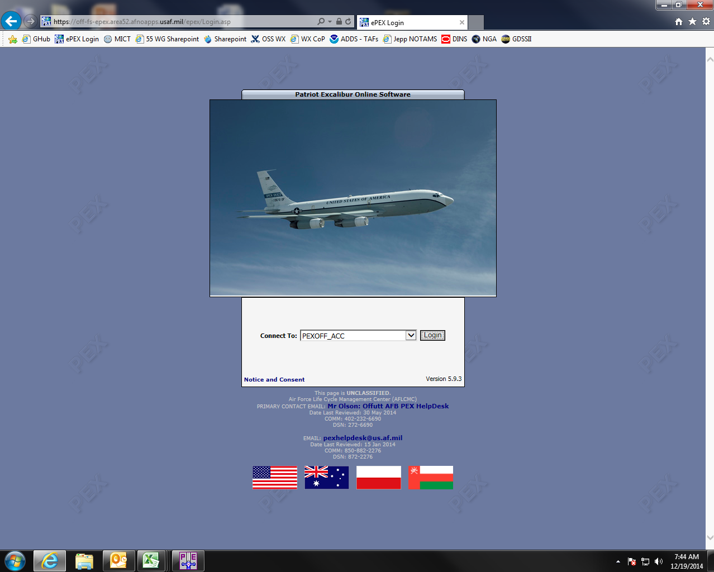
Log onto PEX from any “.mil” computer: https://epex.55wing.af.mil/ePEX/Login.asp

Slide 3
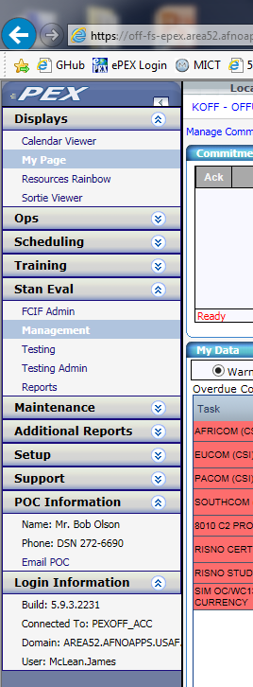
In PEX, Select the Management option under the Stan Eval heading

Slide 4
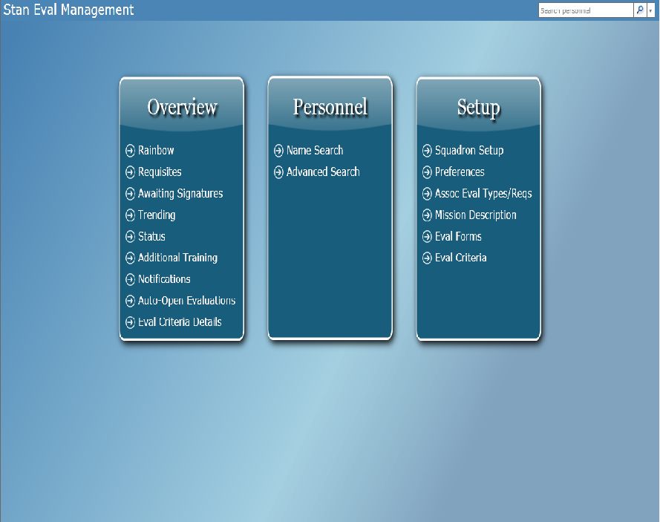
From the Management Home Page, Select Name Search From the Personnel column.

Slide 5
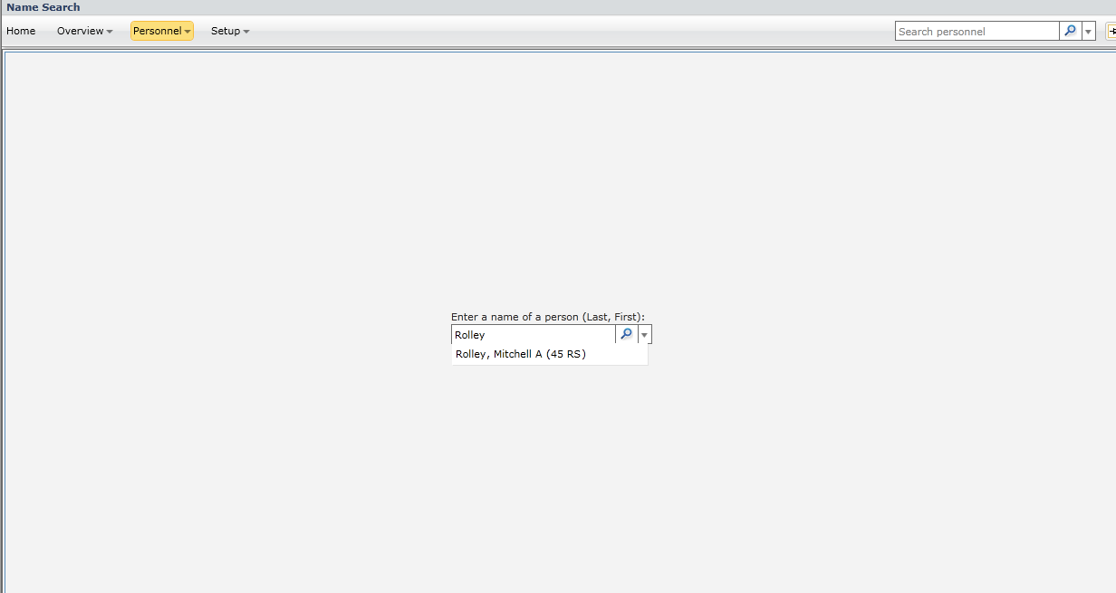
Enter the name of the evaluatee in the search box, select the appropriate individual. Then click on the magnifying glass.

Slide 6
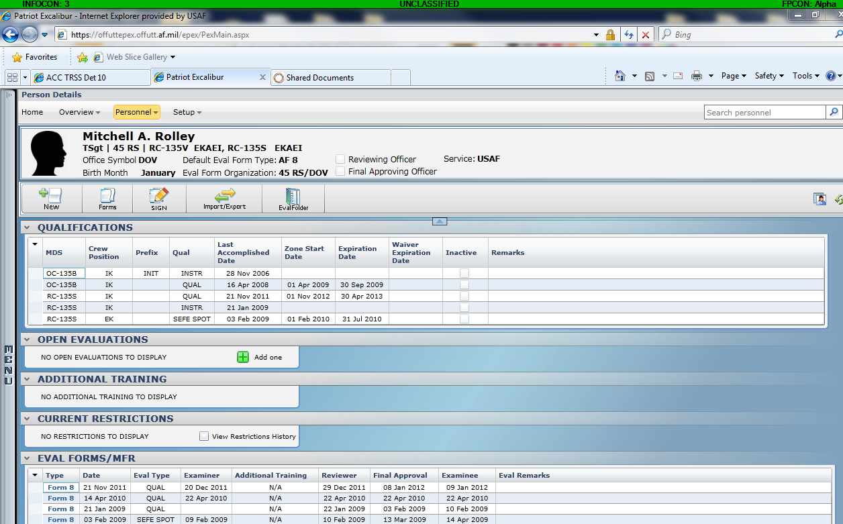
The individual’s Eval may be loaded by CCV or a previous Evaluator. If not, you will need to add an Eval. (If CCV has added an Eval already select that EVAL and go to slide 12)

Slide 7
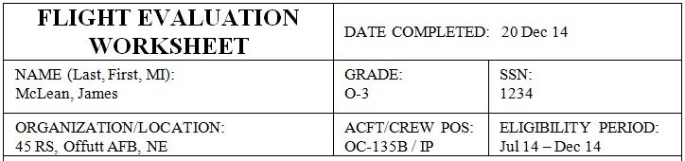
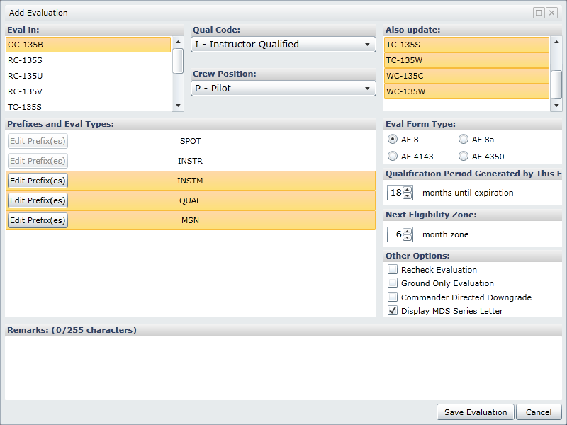
1. Select the correct platform
2. Select Correct Qual Code.
M for QUAL
I for Instructors and Evaluators
E if this was an Evaluator Objectivity
3. Select the correct Crew Position
Note: The following are not proper positions
AC, CP, TC, Raven 3, APMS, Manual, ASE 1

Slide 8
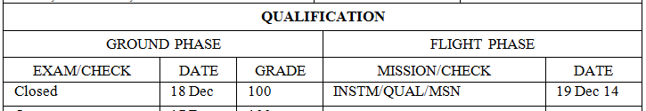
4. For multiple qualified personnel
Select all aircraft this Eval will update
Not necessary for N/N SPOT evals
If this list does not include all of the examinees airframes then go to Stan Eval to have those airframes added
5. Select Eval Types
- For recurring Instructor checks do not select INSTR, only for INIT INSTR evals.
6. Select Prefixes
- For a TF-33 Difference Eval do not select
DIFF

Slide 9
The following should be defaults that do not need to be adjusted
7. Eval Form Type should be “AF 8”
8. Qualification Period is 18 months
9. Next Eligibility Zone is 6 months
10. Check “Display MDS Series Letter”
Note: If this is a Recheck to correct a Q3 then make sure “Recheck Evaluation” is selected
11. Click “Save Evaluation”

Slide 10
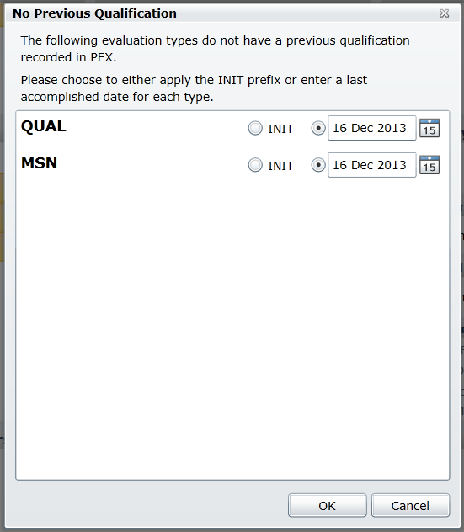
If you see this pop-up after you open the evaluation follow these steps, otherwise skip to slide 12.
If this evaluation is a RQ or INIT qual, then check the appropriate box.
If the examinee has a three month extension waiver move to slide 11.
If the first two options don’t apply then do the following:
  check to make sure the examinee isn’t outside their eligibility period
  change the dates to the dates of the examinee last evaluation and click ok.

Slide 11
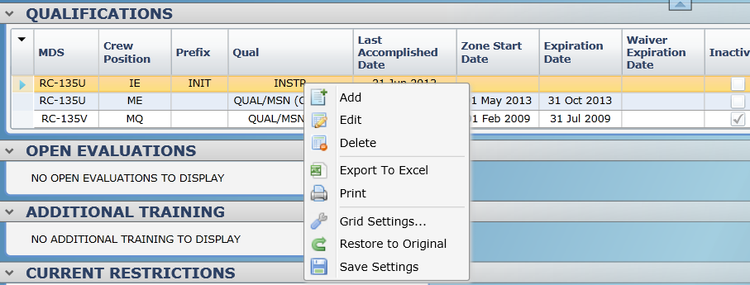
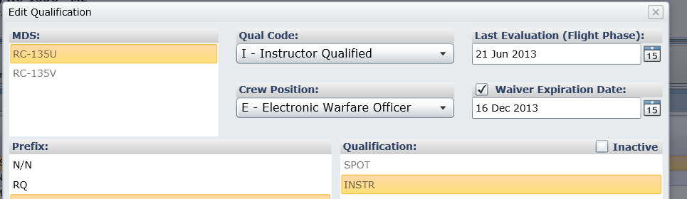
How to add a 3 month extension waiver in PEX.
Go back to the individuals main screen.
Right click the previous qual can click “Edit”
On the next screen click the box next to the “Waiver Expiration Date:” line, and add the date the waiver expires. (Usually 3 months after the original eval expiration.)
Once this is done go back to Slide 6.

Slide 12
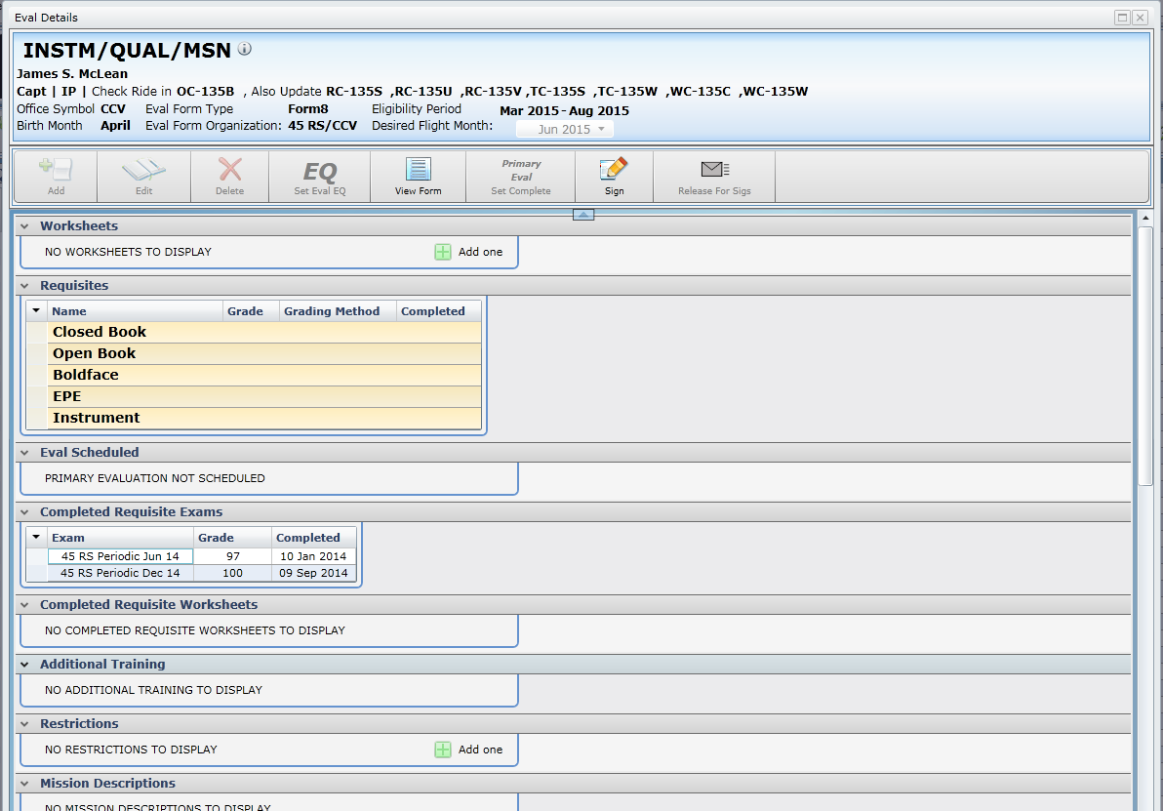
Next you need to add a worksheet: Select Add One from worksheet window or you can use the add button as well and click on add worksheet.
Note: If multiple events with different evaluators are required to complete the evaluation, separate worksheets will be created for each event. This will ultimately populate the back of the Form 8 with each event, evaluator signature blocks and the ability to digitally sign the individual events.

Slide 13
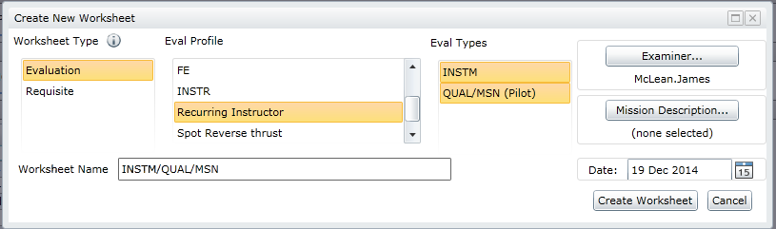
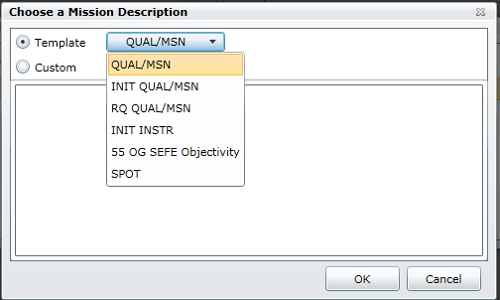
1) Select Evaluation
2) Pick the Eval Profile (INIT INSTR, QUAL, SEFE, etc)
3) Ensure Eval Type is correct
4) Select Examiner (brings up window with list of evaluators, use search bar at the top to find evaluator quickly, select and click OK)
5) Enter the correct type of Eval in Worksheet Name Box This is where you type in exactly how you want qual to read (i.e. QUAL/MSN, INIT QUAL, etc) in the Flight Phase block on the Form 8. Delete anything extra like the (ASE1) pictured below.
7) Select the Date: Enter date flight eval was conducted
Then
8) Click Create Worksheet
6) Click on Mission Description Button
Ensure template is selected, Select the appropriate description Fill in necessary data in template & ensure it accurately describes the sortie profile, then click OK.
*For many of the crew positions, there is a statement similar to: Requisites and flight satisfy all requirements for the ____ position on RC-135X aircraft pre built in the Mission Description & directions to cut & paste from there into Additional Comments. There is no “right click” option so highlight the sentence and use “Ctrl + C” to copy it then hit delete button to remove from Mission Description. Later when you get to the Additional Comments section use “Ctrl +V” to paste it as stated on slide 22.

Slide 14
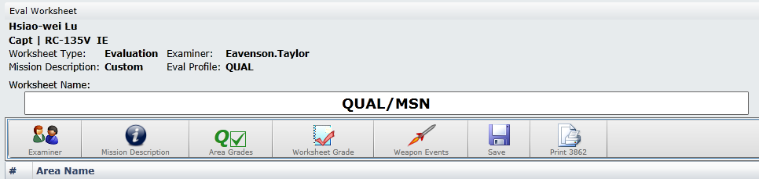
AF 3862 (Flight Eval Worksheet/Temp Form 8)
Once the Evaluation and Worksheet “shell” have been created, Print out the AF 3862 (Flight Evaluation Worksheet)[replaces the 55OG Form 8a] to take on the Flight. This serves as a Worksheet note taker to later fill out the Worksheet/Form 8 in PEX and can serve as a Temp Form 8 in the event PEX is not available.
Click the “Print 3862” button to open and print or export.

Slide 15
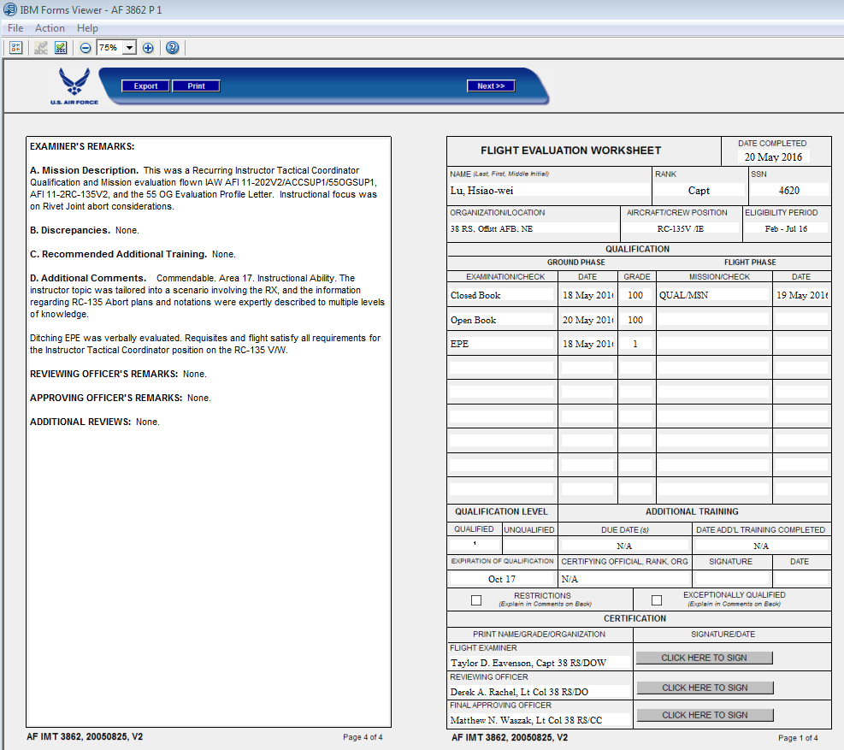
Click Print here.

Slide 16
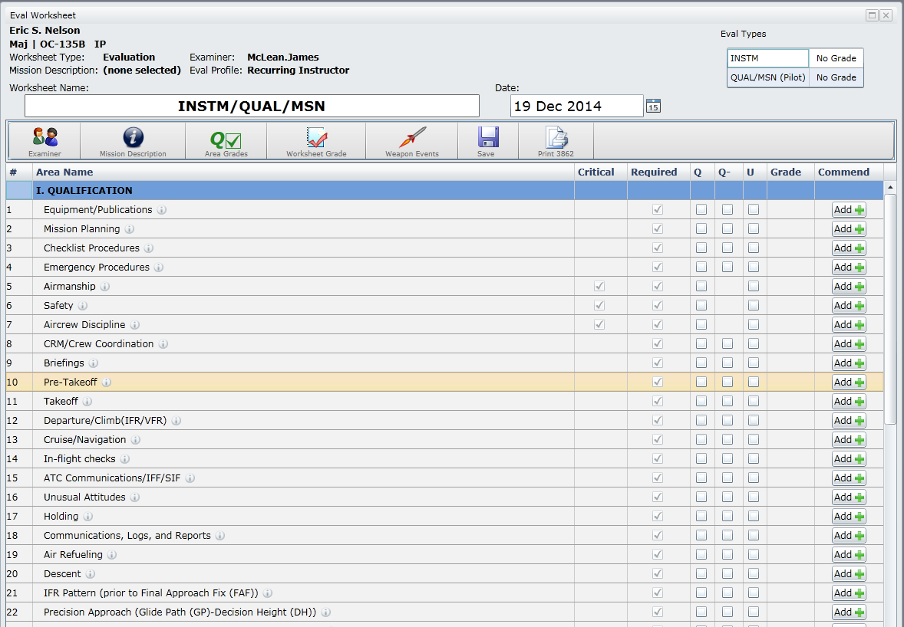
Once the evaluation is complete, its time to fill out the worksheet in PEX.
The individual’s Eval can only be graded by the Evaluator. Select appropriate grade for each area. Refer to 11-2RC135 Vol 2 for grading criteria, do not use information bubbles next to each area.
If selecting grade other than Q, another window will automatically pop up with additional items to fill out. See Next Slide for details.
To set the OVERALL GRADE, select Worksheet Grade and select appropriate grade, it will up date here.
Verify Worksheet Name & Date is correct, again this is how it will appear on the flight phase of the Form 8, Should read Qual/MSN, Init Qual, etc. you can edit from this page if necessary.
Once ENTIRE worksheet (including discrepancies & commendable’ s) are complete click Save
To add an evaluator comment for any area graded commendable, click on Add at the end of the line for the graded area, type your comment and hit save.

Slide 17
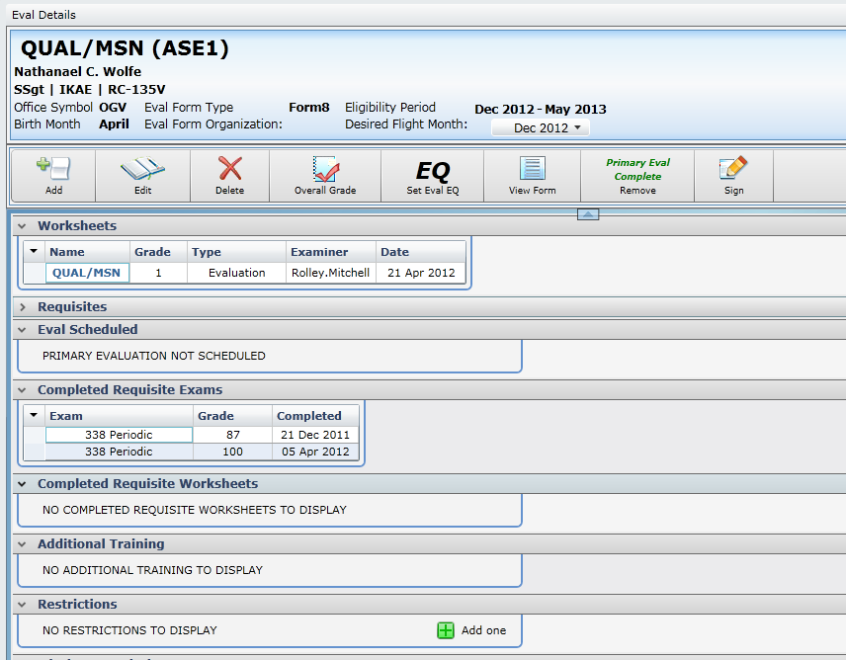
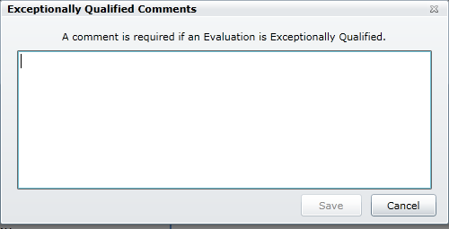
If the evaluatee is receiving an EQ, Click the EQ set Eval EQ button.
This pop-up window will appear, annotate EQ IAW AFI and click save.

Slide 18
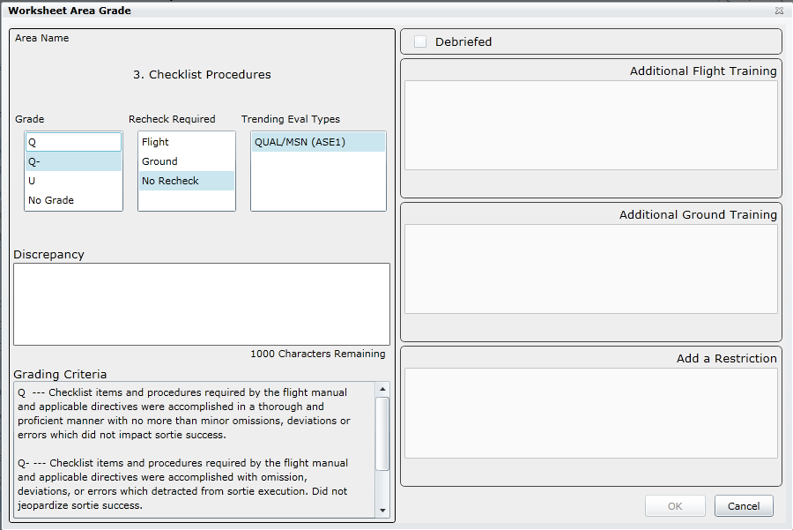
If selecting grade less than Q, This window will automatically pop up with additional items to fill out.
If grade is a Q2 or Q3, Let CCV and leadership know right away.
If Recheck is required (Q3), select Flight/Ground as appropiate. If not (Q2) select No Recheck.
If the discrepancy was debriefed and does not require additional training check this box.
The grade should already be selected, but verify.
If additional training (flight/ground as appropriate) is required annotate it here.
All grade less than Q require discrepancy annotation. Enter annotation IAW AFI guidance here.
If restriction (i.e. Supervised Status) is necessary, enter it here IAW AFI.
Once complete, select OK.

Slide 19
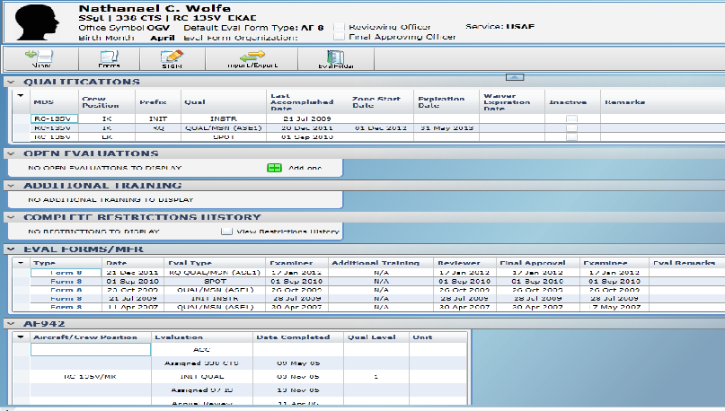
After Additional Training is accomplished it must be signed off in PEX. Go to Individuals Open Eval Details and select sign off under additional training. It will open a box where you can select the instructors name that completed the training.
There would be an icon to click on just like there is for open evaluations.
This will put the date on the Form 8.
There will also be a Additional Training Officer signature block to sign off that will fill in the rest of the AT blocks.

Slide 20
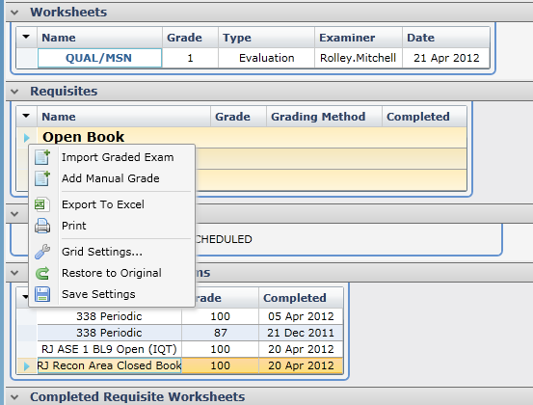
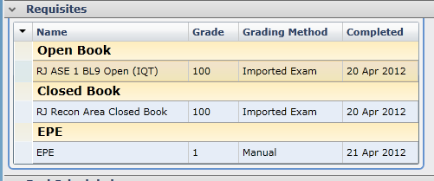
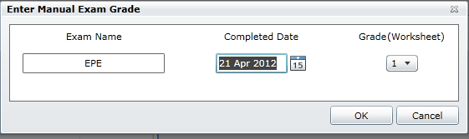
Next enter in the Requisite Grades:
1) Right click on each exam (Open/Closed Book) and select Import Graded Exam, another window will pop up, choose the appropriate grade exam and click import. (This will pull the grade from the PEX database, if examinee took and offline exam/paper copy, select Add Manual Grade and input examinees grade.) Evaluator will have to manually input the EPE/Bold Face/INSTM grades as well.
2) The final product should look something like this:
Manual grade entry example:
Make sure the dates are within the eligibility period unless it is a N/N QUAL or INIT QUAL !
The correct order for adding scores is: Closed, Open, Boldface, EPE and Instrument. If PEX does not input the requisites in the correct order, the setting for the Squadron are incorrect. You will have to correct the seting via Squadron Setup from the Stan/Eval Management page. Ask your CCV.

Slide 21
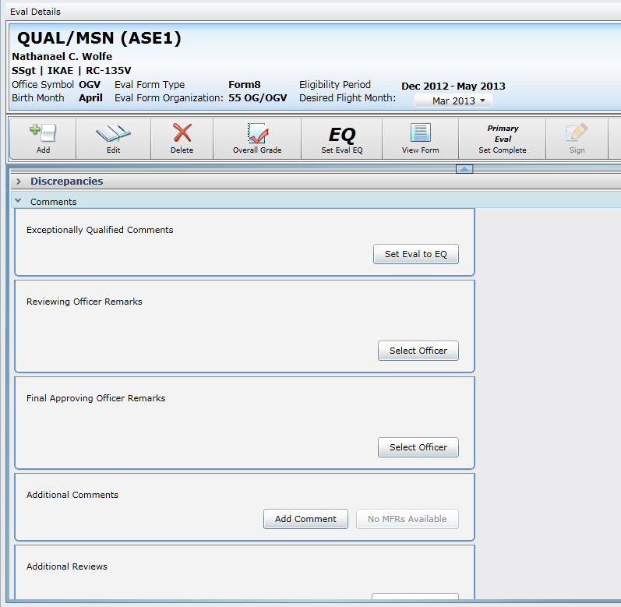
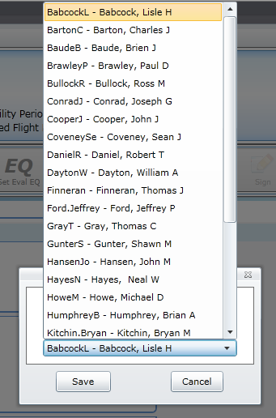
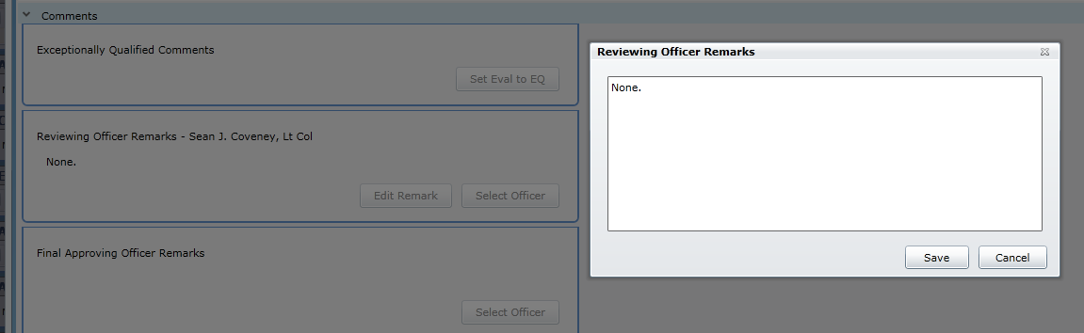
To add Reviewing/Approving Officer signatures scroll down and expand the Comments if not already expanded.
A window will pop up, expand the drop down menu, select the name (Reviewing Officer = Sq/DO, Final Approving Officer = Sq/CC) and click Save.
Then click Select Officer for the appropriate signature.
For Q2/Q3s only, additional comments will be required, consult DOVs/OGV for further guidance.

Slide 22
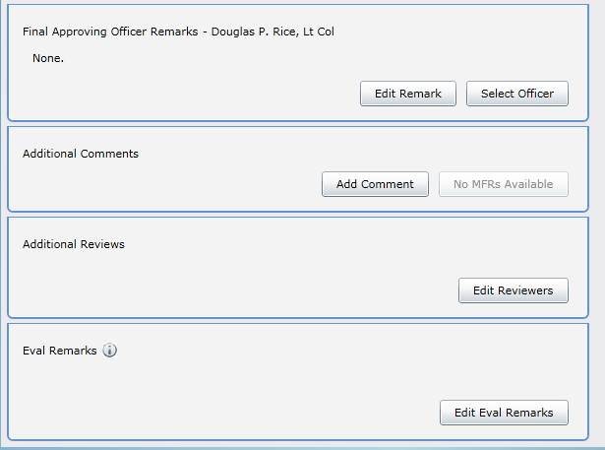
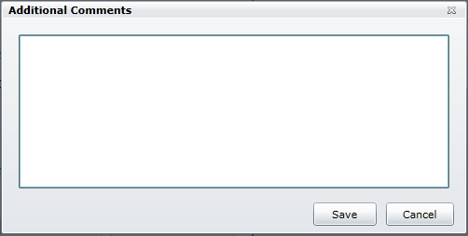
For Additional Comments click Add Comment
This window will pop up. This is where the statement: Requisites and flight satisfy all requirements for the ____ position on RC-135X aircraft. gets pasted “Ctrl +V”.
*For many of the crew positions, there is a statement similar to: Requisites and flight satisfy all requirements for the ____ position on RC-135X aircraft pre built in the Mission Description & directions to cut & paste from there into Additional Comments. There is no “right click” option so highlight the sentence and use “Ctrl + C” to copy it then hit delete button to remove from Mission Description. Later when you get to the Additional Comments section use “Ctrl +V” to paste it as stated on slide 20.
Also any waivers, reasons for requals, etc, must be included in here. See slide 21 for examples.
Once complete click Save.
For ANG crewmembers, route Form 8 from Approving Officer to applicable ANG commander for additional review prior to filing in FEF. ANG commander signature is no longer required on back..
*If any waivers for the evaluation were required, they need to be annotated in the additional comments section as well. Theses annotations can be before or after the Requisites Statements seen over here.
Generic waiver descriptions can be found on the next slide
For Q-3, Additional OGV review required.
I certify accomplishment of recommended additional training. Initials:________
Additional Reviews: Additional Training Completion reviewed by 55 OG/CC. Initials:________

Slide 23
Waiver Descriptions
Prior to Eligibility Period
Authorization to conduct an evaluation prior to the eligibility period was approved by 45 RS/CC IAW AFI 11-202V2/ACCSUP1/55OGSUP1.
In-Theater
Authorization to conduct an evaluation OCONUS was approved by 45 RS/CC IAW AFI 11-202V2/ACCSUP1/55OGSUP1.
Higher Level FE
A higher level Flight Examiner was not available; evaluation was conducted by a [Enter Level of FE (i.e. Squadron)] Flight Examiner IAW AFI 11-202V2/ACCSUP1.
Three Month Extension
Authorization for a three month extension due to {Reason} was approved by 38
RS/CC IAW AFI 11-202V2/ACCSUP1 para. 5.8.3.2.3.
Requisites and flight satisfy all requirements for the [Insert Crew Position(s)] on the [Insert Platform(i.e. RC-135S or RC-135U] aircraft.

Slide 24
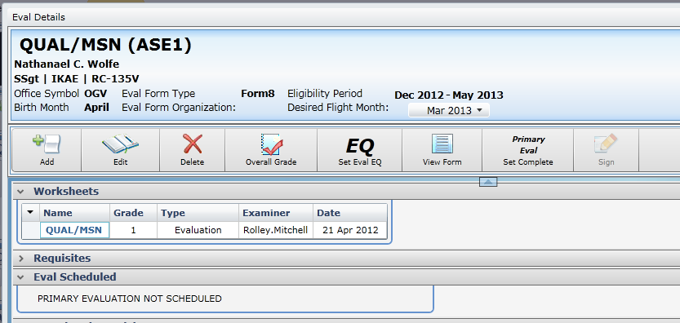
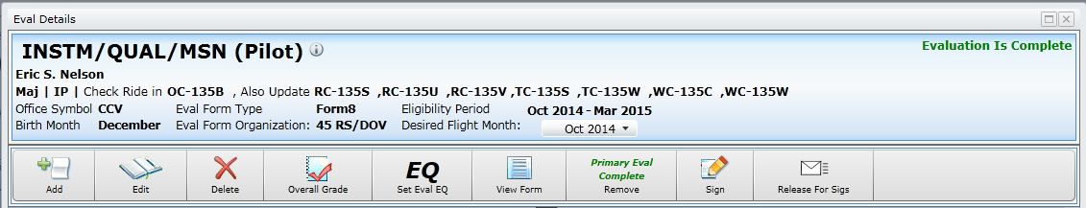
After the worksheet is complete, all requisite grades are input and signatures blocks added, click on Primary Eval Set Complete.
This will populate the Form 8 and AF 3862 (Flight Evaluation Worksheet) with all the data and status will change to Complete.

Slide 25
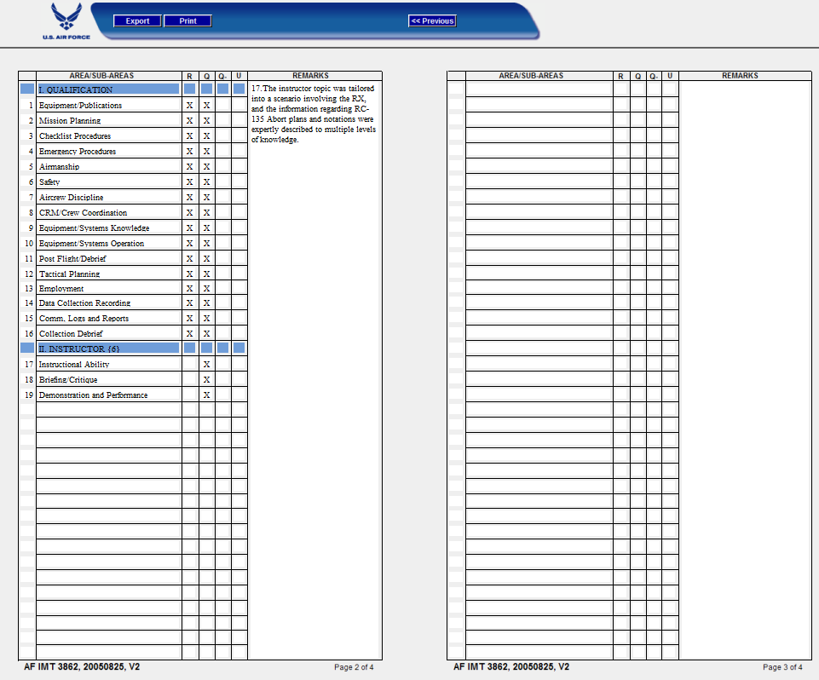
Next step is to create the Temp Eval Form. To do so open the AF 3862 (see Slide 14). Verify everything is correct.
After review only the evaluator will digitally sign the AF 3862 here.

Slide 26
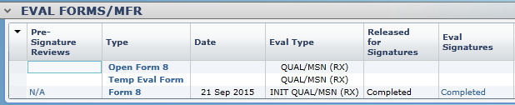
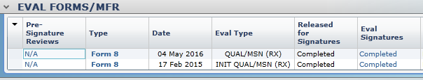
This will automatically create a Temp Eval Form (AF 3862) and post it in the Eval Forms/MFR section of the eFEF. (This serves as and replaces the old 55OG Form 8a.)
Once the signature process for the Form 8 begins the Temp Eval Form will turn into a Temp Form 8 until the “Open” Form 8 gets all its signatures. Then the Temp Eval Form will automatically disappear and the Form 8 will show signatures completed.

Slide 27
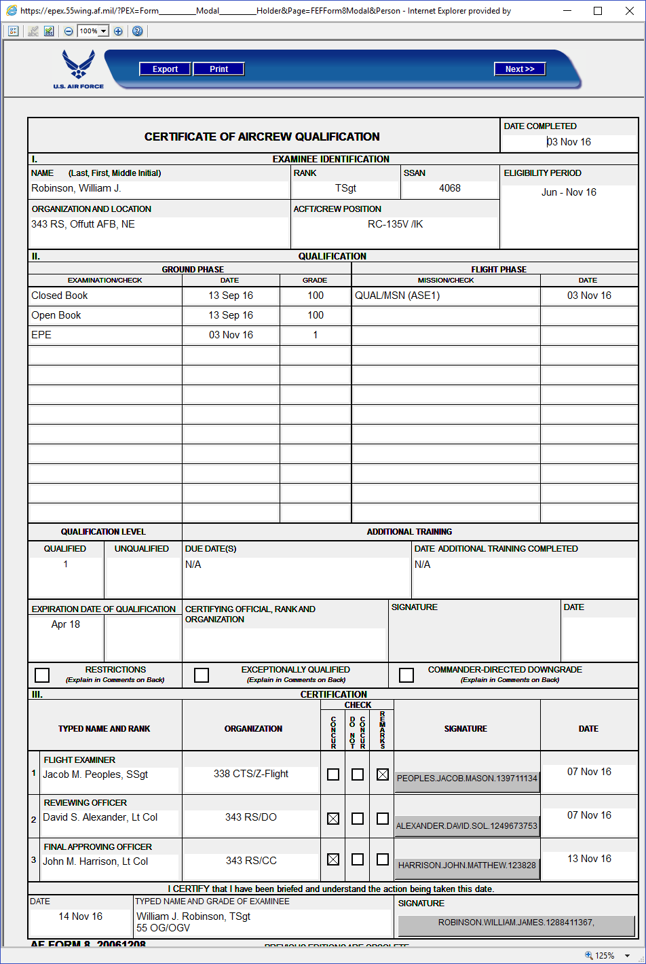
Now is time to review the Form 8 for errors and submit to your CCV for review before signing.
If you have Check marks and not X’s, fix it in the preferences menu here: Advanced Settings/Use “X” style Check Boxes.
Once the front is correct click the “Next” button in the upper right corner to check the back for errors. See Slide 29.
Ensure that all of the examinee’s information is correct, and that the appropriate scores are entered as well as the type of evaluation, and the overall grade.
If additional training is required, ensure the due dates are entered. Next, ensure that the expiration date of the qualification is entered as well as any comments that are required on the front of the Form 8 (such as EQ, Restrictions etc.)
Use the OGV Form 8 Process Guide from the Intelink page to QC your product.
If Org info did not populate correctly see slide 28.

Slide 28
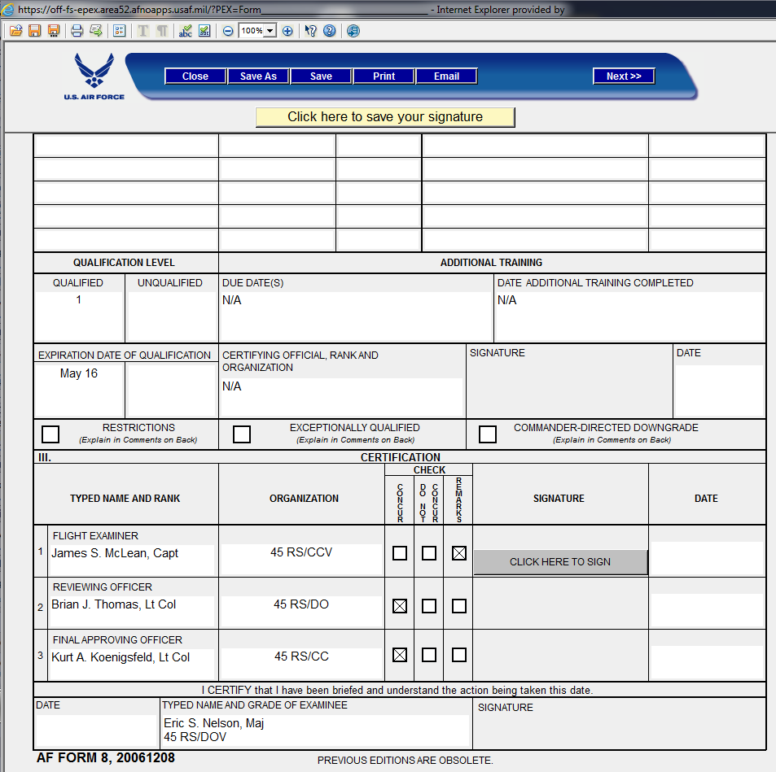
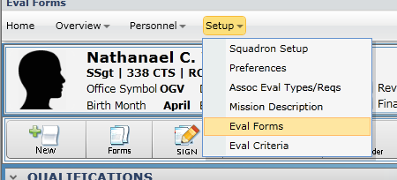
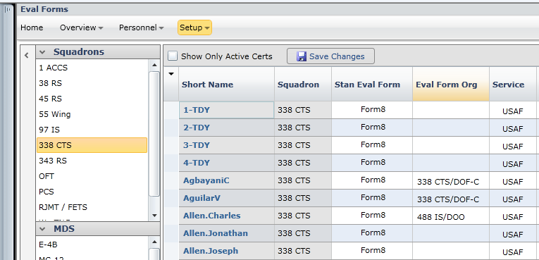
PEX 5.9 adds the Sq/Office symbol into this line, that is IAW 11-202-Vol II, 7.3.4.2.1, if it does not show up, the members info needs to be updated in the Setup/Eval Forms section as shown below.
This window will come up, add the org/office symbol to the Eval Form Org column & click save changes.

Slide 29
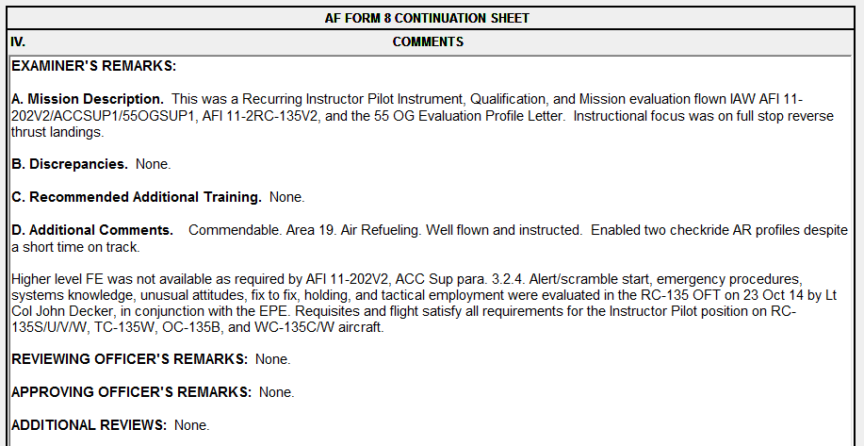
Ensure that the appropriate information for each area is entered on the back of the Form 8.
Use the OGV Form 8 checker from the Intelink page to QC your product.

Slide 30
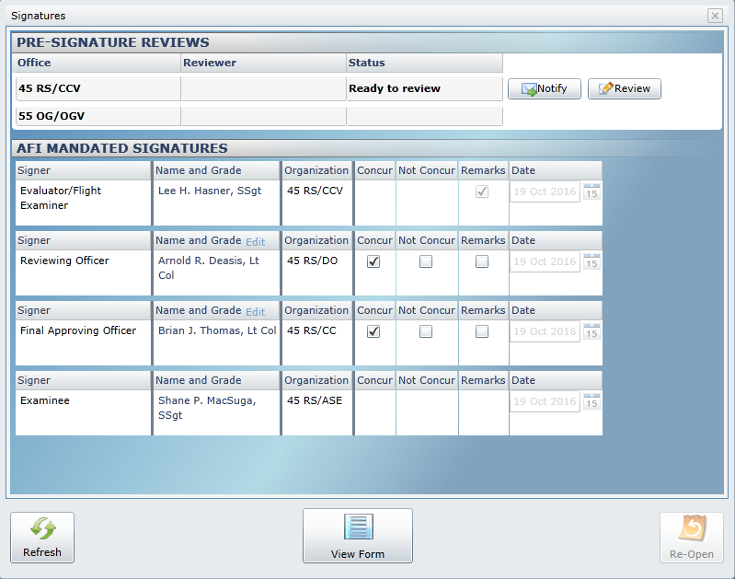
To notify the CCV that the form 8 is ready to be reviewed click the Sign button
Click the notify button in the window that pops up. This will open a preformatted email message. Ensure proper CCV org box is in the “To” line and send the message.
CCVs will ensure Form 8 corrections are made (if needed) and then notify OGV when Form 8 is ready for review.

Slide 31
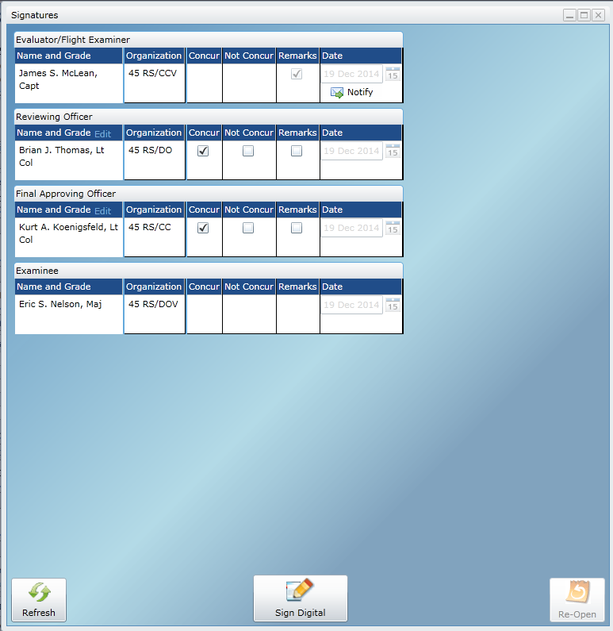
Once OGV reviews and releases for signatures its time to Sign the Form 8. Click the Sign button.
Once this screen appears click
“Sign Digital”
A digital Form 8 will appear.

Slide 32
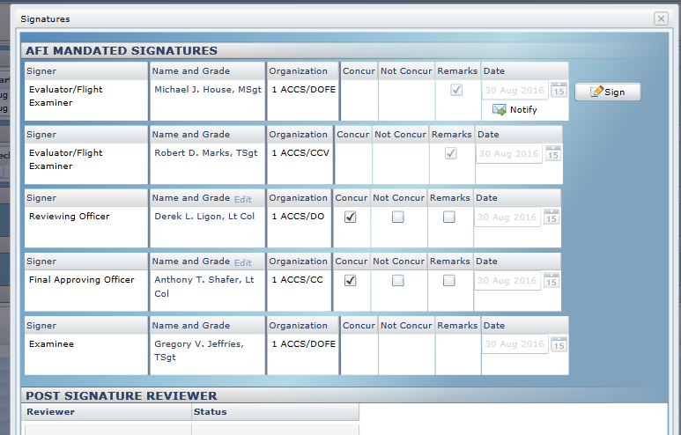
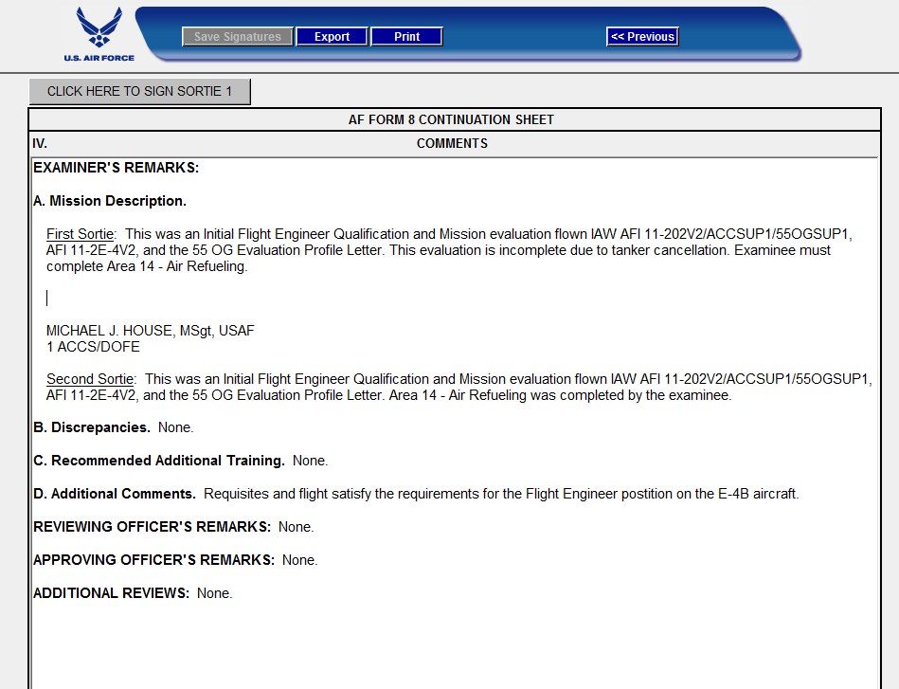
If multiple sorties were accomplished by multiple examiners there will be an additional examiner signature block populated. Signatures will be in order of occurrence.
“CLICK HERE TO SIGN”
Descriptions from all sorties will populate here, with the option for each examiner to sign.
“CLICK HERE TO SIGN”

Slide 33
The final examiner will sign the front of the Form 8.
“CLICK HERE TO SIGN”

Slide 34
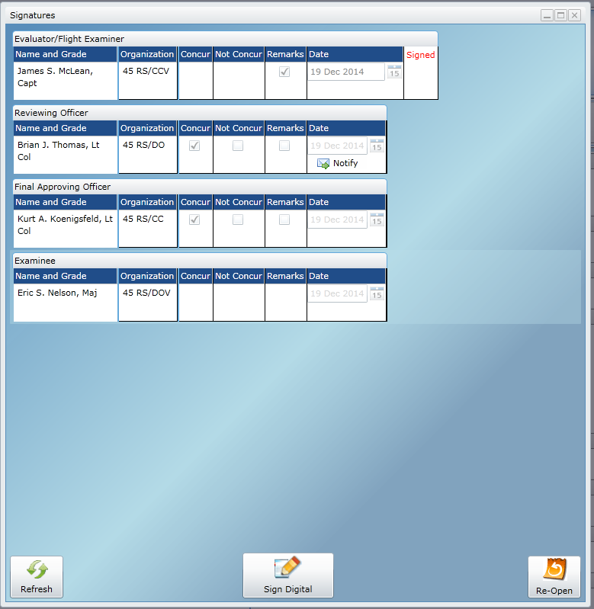
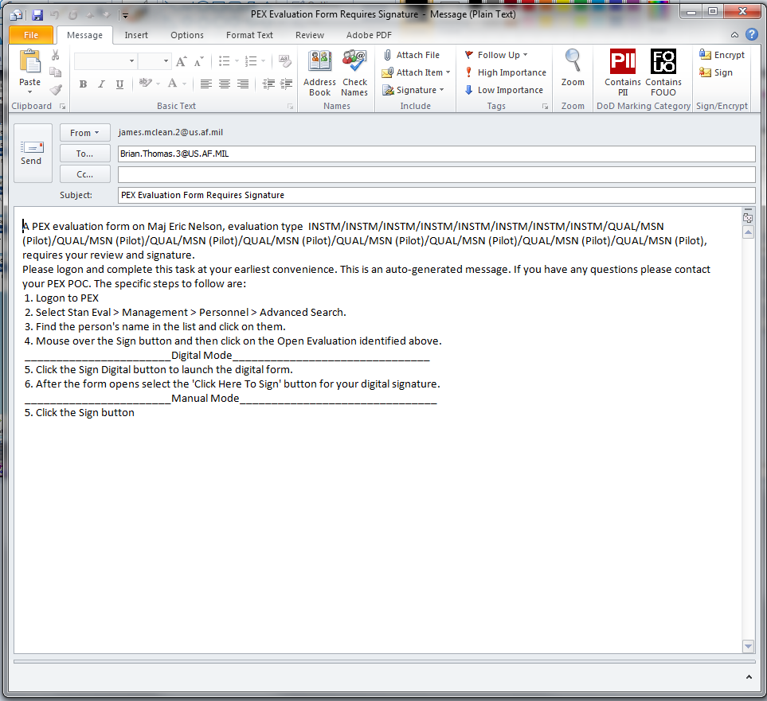
Once this screen appears click
“Notify” to send an email to the Reviewing Officer
Outlook will automatically open with a pre-formatted email

Slide 35
If you have any questions or would like to recommend changes please contact 55 OG Standardization and Evaluation
CONGRAGULATIONS! YOU ARE DONE!

